Slide 1



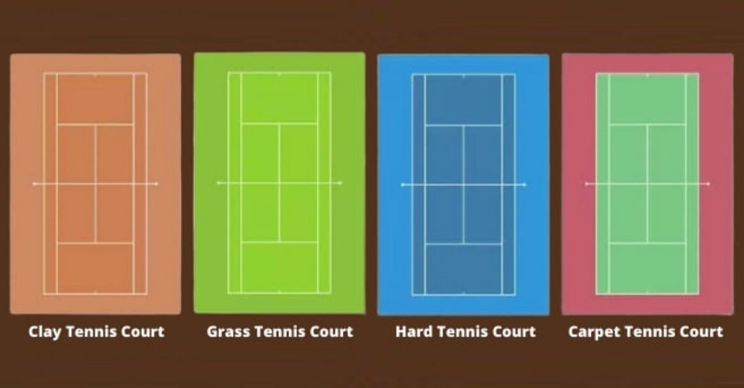
The Evolution of Professional Tennis
Essential Question: “To what degree has improved racket technology and court homogenization changed the game of professional tennis over the last 5 decades?”
Definitions:
Grand Slams: Biggest tournament type (4 per year)
Masters 1000s: Second biggest tournament type (9 per year)
Court surfaces: Hard (concrete), clay, grass, and carpet

